Slide 1

What’s in your nest egg? Maximizing income for the next stage in your life.
Notes:
Good [morning/afternoon/evening]
Thank you for coming. Most of you know me – I have had the pleasure of being your [Financial Advisor/Financial Planner/Advisor] for a number of years. But for those of you who don’t let me introduce myself. I’m [Name] and I’ve been [in the financial services industry/an advisor] for XX years.
[Add more information about yourself or your personal welcome remarks as desired].
A client said to me the other day “I’ve never retired before so I have a lot of questions”. I thought it was a funny thing to say, but it actually highlights an important fact - retirement is a new experience for most people and when it comes to retirement income, there are lots of variables that need to be taken into consideration.
You’ve had years, maybe decades to save and prepare for whatever it is you want to do next. Along the way, you’ve likely had to make adjustments for life events. You may have even had to correct certain choices, or perhaps you have been able to take advantage of new investment strategies. During your peak earning years, it’s easier to make these adjustments.
But when you stop working or scale back your work hours, it’s important to know about all your options and sources of income because your ability to get back on course should things not go as planned is more limited.
Now that the next stage of your life is on the horizon, it’s time to re-assess your overall income picture. Using information from BMO, and Government of Canada resources, I will provide you with an overview of the most common income sources for retirement and the key considerations. Of course each of you has unique goals and needs, so I will cover the basics and look forward to sitting down with you one-on-one in the following weeks to review your individual plans.
The presentation will be about 45 minutes with time for questions at the end, but please feel free to ask if you have any questions as we go along.

Slide 2
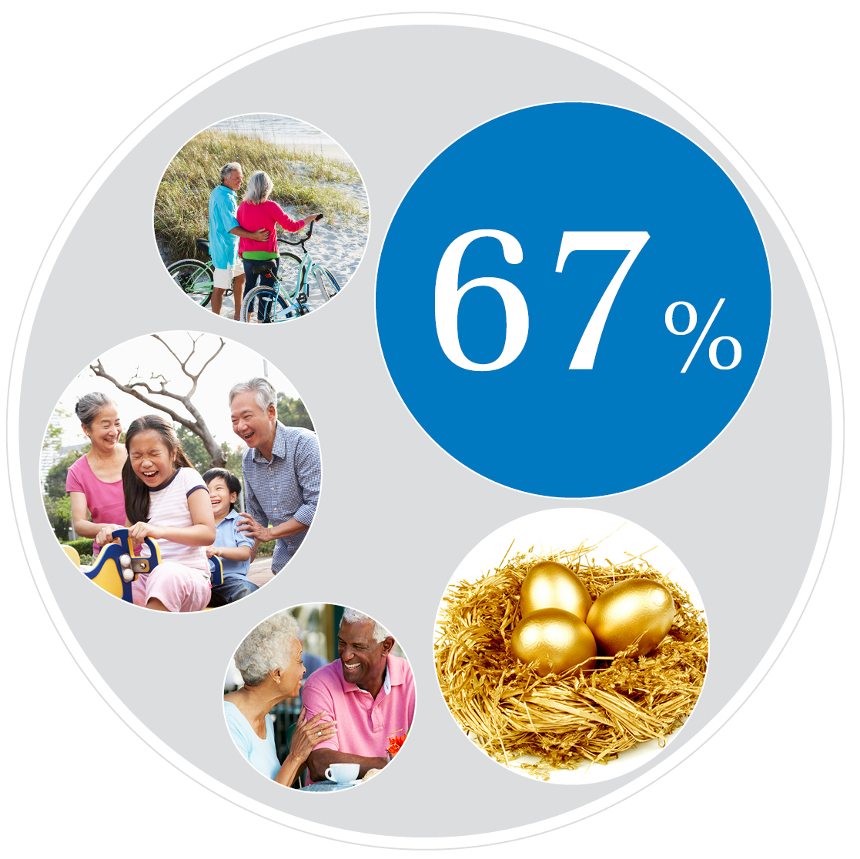
Funding the retirement you want
Notes:
The BMO Wealth Institute conducted a study in February 2016 about how Canadians felt about retirement and 67% of respondents who were transitioning to retirement cited “running out of money” as a top concern.
While everyone’s retirement income needs may differ, we all seem to have at least one common goal – to ensure that our income lasts and lets us enjoy the retirement we want. That’s why it’s so important to maximize the income sources that you will be drawing on for the next part of your life.
Regardless of what you want to do next, you’ve worked hard to save for it. But there’s more than just your personal investments to consider when thinking about where your income will come from.
How much can you get from the government and other sources to help fund your retirement? What key considerations about these income sources need to be assessed so you meet your needs and objectives? This is exactly what we will discuss today.
As you approach and enter retirement, you’ll need to make several decisions about your income sources that could affect how much you will receive. I will be available to guide you through that dynamic process to best suit your individual goals and objectives.

Slide 3
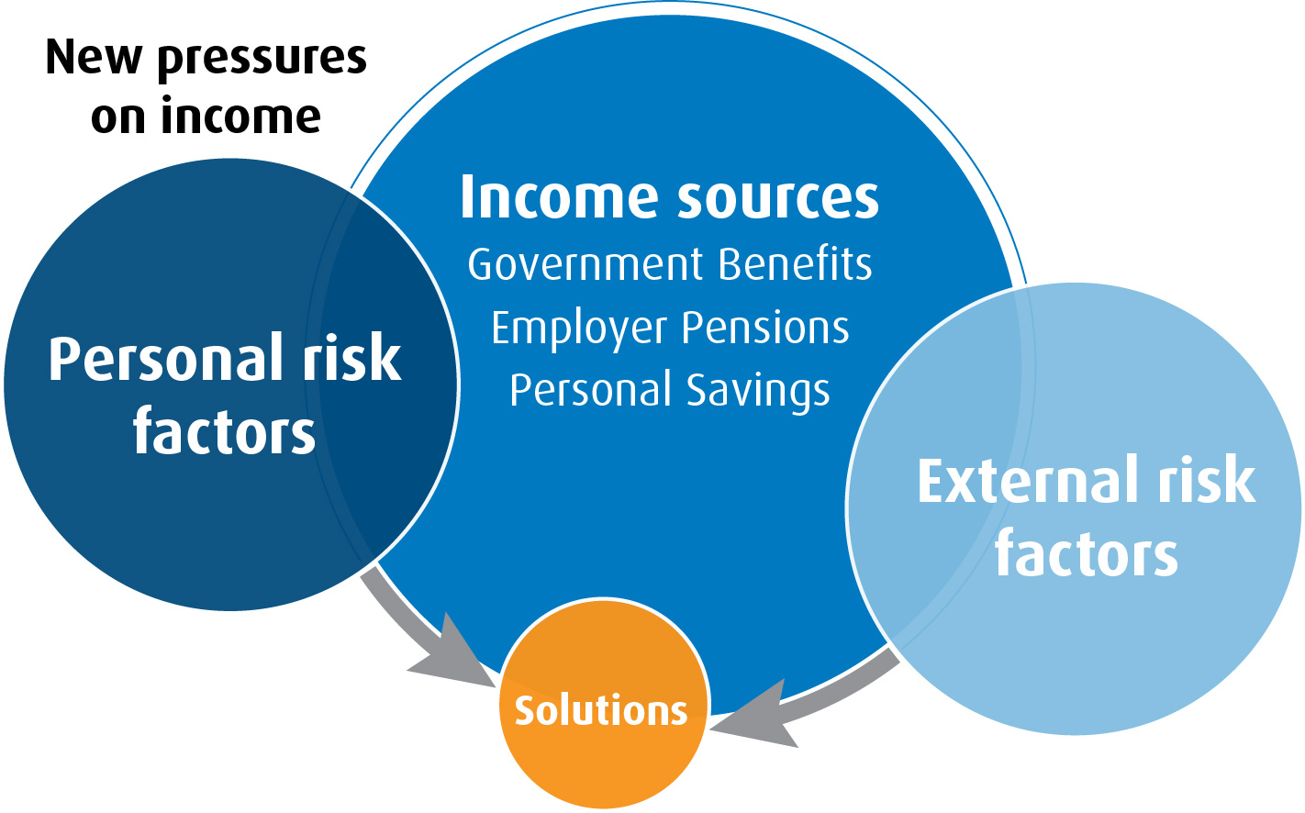
Key considerations
Notes:
There are various risk factors, both personal and external, that can impact your retirement income. Being aware of these will enable you to make decisions appropriate for your unique situation. We’ll start off by looking at some common personal and external risk factors.
We will then review the main sources of income that are generally relied upon for retirement – everything from government benefits to personal savings and investments. We will look at the key considerations associated with each.
Finally, we will look at some new opportunities for generating income at this unique stage in your life.

Slide 4

Retirement income: personal risk factors
Notes:
Let’s start with the personal risk factors and considerations that can impact retirement income.

Slide 5

Living longer
Age 84
Age 87
Life expectancy at age 65
Longevity Risk: risk of outliving your money
Male
Female
Source: StatsCan, May 2012.
Notes:
How old is the oldest person you know? 85? 95? Canadians are are now living 8 to 10 years longer than we did back in the 1970s. With life expectancies at about 84 years of age for men and 87 for women, retirement could last 20 or 30 years. What if yours is longer than you anticipated?
Longer life spans create longevity risk – this is the risk of out-living your retirement savings.
That’s why it’s important to consider if you will have ample money to sustain a long retirement.

Slide 6

Increasing health care costs
There is a 50% chance of requiring long-term care by
age 75.¹
Canadians
expect to spend
an average of
$5,000 a year
on out-of-pocket
medical costs
after age 65.²
Source:
¹ Fraser Institute, dates from 2004-2014
² BMO Wealth Institute, Living to 100: The Four Keys to Longevity, July 2014
Notes:
Your health, good or poor, will impact how much income you need.
Good health leads to living longer, and as we just touched on, that requires income for a longer period of time.
Poor health means that you may need to pay for treatments or require long term care beyond what is covered by a public health care system. In a BMO Wealth Institute survey conducted in July 2014, Canadians said they expect to spend an average of more than $5,000 a year on out-of-pocket medical costs after age 65; factoring in inflation, that number will certainly be higher in the future.
According to Statistics Canada, there is about 30% chance by age 65, and about a 50% chance by age 75 of requiring long-term care.
Source: Retirement Planning Presentation, BMO Wealth Institute
Source: Canadians Ill-Prepared For Long-Term Care Costs. Benefits Canada Website. June 22, 2012. http://www.benefitscanada.com/benefits/health-wellness/canadians-ill-prepared-for-long-term-care-costs-29917 (accessed June 2014)

Slide 7



Supporting multiple generations
Notes:
Some of you may be able to relate to this scenario:
I have a client supporting a daughter who’s studying to get her Masters Degree. My client’s mother has recently developed some medical issues and requires care on a daily basis, and while there is some limited care available from the government, it’s not enough. So my client is seeking additional services that she will be paying for herself to support her mother. And this is happening with her retirement on the horizon in less than 5 years.
We’ve probably all heard the term “sandwich generation” to describe this very situation, where people are sandwiched between the demands of caring for both their aging parents and for their own children.
If you find yourself in that place now, or think you may be there in the near future, it’s important to consider how it may affect your retirement income needs.
Source: Retirement Planning Presentation, BMO Wealth Institute

Slide 8

Other personal considerations
Monthly expenses
Travel and other hobbies
Going back to school
Life events – disability, divorce, death of spouse
Leaving money to family/friends/charity
Notes:
In addition to the personal risk factors, your personal interests, goals and lifestyle also need to be taken into consideration. I have had the pleasure of discussing retirement plans with many of you. I like hearing about what you want to do and working with you to determine how much retirement income you require.
Retirement income planning also requires that some thought be given to how unfortunate life events, such as divorce and death, would impact your available income.
By sharing your goals, and considering the risk factors, you will start to get a clearer picture of your retirement income.

Slide 9

Retirement income: external risk factors
Notes:
Let’s look at the external risk factors that can impact your retirement income.
Some of the biggest external risk factors are volatility, sequence of returns and inflation.

Slide 10


Volatility: Impact to investments
30+ years to make up losses
Drawing on savings within two years
Notes:
In finance, volatility is the degree of variation of an investment’s price over a period of time (as measured by the standard deviation of returns). Volatility is a concern for all investors since it creates uncertainty and can impact investment performance. But it is especially concerning if you are approaching retirement because of where you are in relation to the investment phases of your life.
Let’s look at 2008/2009 as one of the most volatile times in the market we’ve seen in recent memory.
Imagine that during the downturn an investor lost 40% of your investment. If you were in your 30s, you had time on your side and could afford to stay invested in the market to regain your losses and continue to grow your assets.
Not so if you were approaching retirement. First, years of accumulated savings would mean more assets that were lost. Secondly, because you would have been closer to when you needed to access your savings, you would have had less time to rebound from the losses.
For many investors in 2008/2009, a 40% loss meant getting out of the market and having to revise their expectations about the type of retirement they expected to enjoy because they didn’t have the luxury of time.

Slide 11
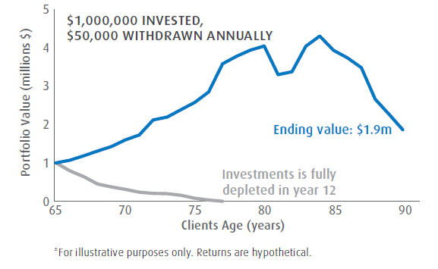
Sequence of returns – impact to Cash Flow
Hypothetical Example
Positive years at beginning of retirement
Negative years at beginning of retirement
Source: BMO Global Asset Management. Returns based on hypothetical average rate of return of 4.7%.
Notes:
So what happens when you move from saving for your retirement to spending in your retirement?
When you start to use your investments for cash flow the sequence of your investment returns becomes extremely important. Sequence of returns is basically the order of returns – i.e. having a number of negative years in a row or a number of positive years. The illustration on the screen shows the difference between those two scenarios can be huge.
In one example, a client takes $50,000 a year from a $1,000,000 portfolio beginning at age 65. The portfolio is depleted entirely by the time they reach 77 because of negative returns in the beginning of their retirement.
In the other scenario the client also takes $50,000 a year, but they end up growing their investments over time because the returns were positive in the early years of retirement.
Why does that happen?
If you have negative returns particularly at the beginning of your retirement you have less principal investments available to grow over time and have to draw down from an already reduced portfolio.
This is why it is so important to understand and consider the sequence of returns risk for your portfolio, especially as you get closer to retirement. Without protection from sequence of returns risk, there is a significant threat to the sustainability of your retirement income.
If you’re wondering what you can do about managing sequence of returns – there are products that are designed to specifically address this risk that I can help you choose based on your individual needs. We will look at these a little later on in the presentation, but it’s important to know that there are solutions to address this risk factor.
< Insert source for the graph >
Source: Retirement Planning Presentation, BMO Wealth Institute

Slide 12

Declining returns and inflation
Guaranteed Rates have changed
GIC (5 year) rates:
1980: | 13.2%
2016: | 1.5%
50 years ago…10 cents
Today…$1.65
Source: Bank of Canada, Data & Statistics. Published 2016 GIC rates on bmo.com and rbc.com April 2016.
Notes:
So with the risks of volatility and sequence of returns, why do you need to invest in the market at all? Wouldn’t it be better to put your hard earned investments in GICs? This is a perfect solution - but only for clients who have both a high level of assets and a low level of cash flow needs throughout retirement.
With interest rates at near historic lows investors are getting significantly lower rates of return than in the past. Currently, investors are being offered around 1.5% for a 5 year GIC. This is very different from 35 years ago when you could get a 13% return for the same GIC investment. It’s the difference between getting $1,500 a year from a $100,000 portfolio today versus $13,500 35 years ago.
Another reason why people invest is that over time the prices of things tend to increase. This is known as inflation.
How many of you bought a cup of coffee this morning or in the past week?
If you bought a medium Tim Horton’s coffee today, it cost you around $1.65. That coffee would have cost you only ten cents 50 years ago.
As prices rise over time, the value of a dollar today will fall in relation to what it can buy in the future. Whether it’s buying that simple cup of coffee or doing the grocery shopping, inflation is something almost all of us experience just making daily purchases. Yet many of us don’t consider the effects inflation has on retirement income.
If your investments are not keeping up or outpacing inflation, you will use up more of your savings just to keep up with rising costs of goods and services. Even in times when inflation is low, due to the compounding effect it can have a significant negative impact on your retirement savings and income in the long-term.
The good news is that there are products that provide the potential to outpace inflation and protect your savings. I can help you determine the investments that can potentially provide you with higher levels of cash flow and protect you from inflation risk.
(Source: Retirement Planning Presentation, BMO Wealth Institute).
The average rate on a 5 year GIC in April of 1980 was 13.82%. (Source: Bank of Canada, Data & Statistics, 5 year Average GIC rates, bankofcanada.gc.ca).
Recently published rates from some of the major banks for a 5 year GIC give you 1.5% at the end of the term.
Even with a low inflation rate - at 2% as of January 2016- you will barely if at all be able to outpace inflation on that kind of return.
(Source for GIC rates: bmo.com, rbc.com) (Source for inflation rate: Bank of Canada, Consumer Price Index, bankofcanada.gc.ca,

Slide 13

Retirement income streams: key considerations
Notes:
Now that we have covered the risks, let’s take a closer look at the sources of your retirement income and the key considerations that go along with each income stream.

Slide 14

Income from government
Notes:
There are lots of misconceptions about how much retirement income the Government of Canada provides and the conditions associated with it. Understanding how it works, and the considerations that apply to your personal situation, will determine how you can best use it.

Slide 15
Maximum benefits from federal government pensions
Maximum Monthly Income (approx.)
CPP Retirement Pension (at age 65) | $1,092.50
CPP Post-Retirement Pension (PRB) | $27.31
Old Age Security | $570.52
Total Maximum Monthly Benefits | $1,690.33
Source: Government of Canada Website April 2016 (esdc.ga.ca)
Notes:
The most common question my clients have about federal government benefits is: “How much am I going to get?”
The best-case scenario of the monthly payout from federal government sources – Canada Pension Plan (CPP) and Old Age Security (OAS) - is approximately $1,690.33 per month at age 65.
Depending on your situation, and how this income stream works in conjunction with your other sources of income, you may decide to start collecting early – before age 65 - or delay receiving your benefit. It’s important to know about the options available and the immediate and long term impact of decisions you make.
Let’s start by looking a bit more closely at CPP.

Slide 16

Canada Pension Plan (CPP)
Overview
Current or past employees and self-employed are eligible
Funded by employment contributions
Earliest eligibility age for the Retirement Pension is 60
Benefits are adjusted for inflation
$1,092.50 /month maximum
Source: Government of Canada Website April 2016 (esdc.ga.ca)
Notes:
The Canada Pension Plan is designed to provide a modest replacement of employment earnings during retirement. With very few exceptions, if you have had at least one employer or have been self-employed, you would have contributed to the CPP starting as early as age 18.
Employees and employers both pay into CPP. If you are self-employed, you pay 100% of the contribution, and the premium is based on your net business income (after expenses).
You can start collecting CPP benefits as early as age 60; however as we will see in a moment, there are significant benefits to delaying your pension if possible.
A key feature of the CPP is a built-in inflation adjustment to protect you from loss of value in the future. CPP amounts are adjusted in January of each year based on the Consumer Price Index, which is the most widely used indicator of price changes for goods and services in Canada.
Source: Government of Canada website (esdc.gc.ca)

Slide 17
Canada Pension Plan (CPP)
Other Key Features
Taxable benefits
You must apply
“Pension sharing”
Payable outside of Canada
Social Security Agreements
Working while collecting benefits (Post-Retirement Benefit)
Recent changes to the plan
Post-Retirement
Benefit
$27.31 /month maximum
Source: Government of Canada Website April 2016 (esdc.ga.ca)
Notes:
A few more points about the CPP that are important to keep in mind:
The benefits you receive from the CPP are taxable. You can request that taxes be automatically deducted from your monthly payment.
You must apply to receive the CPP benefit – you are not automatically enrolled.
Pension sharing allows partners who are married or common-law and are both 60 years of age or older, to share the portion of their benefits earned during their time together.
The CPP benefit is payable outside of Canada and can be paid in local currency if the country you are residing in offers direct deposit.
Social security agreements make it possible for the CPP to be coordinated with pension programs in other countries. If you who have lived or worked outside of Canada, your time spent in another country could help you meet eligibility requirements for receiving CPP benefits. Every social security agreement with each country is different, so you need to be aware of the details for your individual situation.
Note to presenter: There are over 50 countries with which Canada has a social security agreement. For a complete list please see ”International Social Security Agreements” on esdc.gc.ca.
A recent change to the CPP has been the introduction of the Post-Retirement Benefit or PRB. The PRB allows for individuals to start collecting their CPP benefits and continue to work while making contributions to the plan. The maximum monthly benefit is $27.31. Mandatory contributions made by the employer and employee are required until age 65. At age 65 an employee can opt out of making contributions. By age 70, contributions can no longer be made.
Other recent changes were made to the CPP regarding benefit increase and deduction rates based on taking CPP benefit early, or delaying it. This is an area where I can assist you so you don’t have to wonder if you’ve missed a change to a policy or the introduction of new rules. I keep on top of the latest federal government policies around retirement benefits and that’s part of what I will account for when we assess your retirement income.
Note to presenter on recent changes to CPP:
The changes will not affect those who started receiving a CPP pension before December 31, 2010, and have stayed out of the work force since that time.
Source: Government of Canada website (esdc.gc.ca)

Slide 18
CPP Retirement Pension
How your benefit is calculated
Maximum benefit is $1,092.50/month
Contributions (amount and duration) + Age determine Benefit Amount
Contributory Period
Age 18 to when you start collecting your pension, turn 70, or pass away
Drop-out provision and Child-rearing provision provide protection for years where contributions were low or non-existent
$27.31 /month maximum
Source: Government of Canada Website April 2016 (esdc.ga.ca)
Notes:
As touched on earlier, there is a cap on how much you can receive from the CPP. $1,092.50 is the maximum monthly benefit any person can receive, regardless of contributions and other factors that determine their benefit amount.
Your CPP benefit is calculated based on the amount of your contributions made during your employment, your contributory period, as well as the age at which you choose to start receiving your pension.
Your contributory period begins at age 18 and ends when you start collecting your pension, turn 70 or pass away (whichever happens earliest).
Note to presenter: Reminder that for individuals who continue to work once they have started collecting CPP, their extended contributory period and contributions go towards the Post-Retirement Benefit.
The CPP protects those who may have stopped contributing for a period of time or who had very low contributions with the Drop-out Provision and Child-rearing Provision. By removing those low-income or no income months from the calculation, your benefit has the potential to be much higher.
Source: Government of Canada website (esdc.gc.ca)

Slide 19
CPP Retirement Pension
Age Matters
When you collect your pension…
At 60 | 60 onward | At 65 | 65 onward | Up to age 70
36% less | 0.6% reduction for each month prior to age 65 | Full Benefit | 0.7% increase for each month up to age 70 | 42% more
Source: Government of Canada Website April 2016 (esdc.ga.ca)
Notes:
When it comes to your CPP retirement pension – age matters!
The age at which you start collecting your pension will have a significant impact on what you receive over your lifetime.
The options you have can be seen as a sliding scale – the sooner you take your benefits the less you will receive. And on the other end of the scale – if you delay collecting your pension, you will receive a larger benefit.
Let’s examine the options and implications of taking an early, full, and delayed pension.
You can begin receiving your full pension at the age of 65.
The government also gives you the option to take an early pension as soon as age 60 with a reduced benefit. However, there is a significant downside to collecting early, as the amount of your pension is reduced 0.6% for each month that you take your pension before age 65. If you do take your pension at age 60, your benefit will be 36% less than if you waited until age 65.
On the other hand, if you delay taking your pension until after age 65, you will receive a 0.7% increase for each month that you take your pension after 65. That works out to a total of up to 42% more if you delay your pension until age 70. It is important to note that there is no benefit to delaying your pension beyond age 70.
Source: Government of Canada website (esdc.gc.ca)

Slide 20
Delaying your retirement pension
Hypothetical Example:
Angela will turn 65 in June of 2021
She anticipates she will be eligible to receive the maximum benefit of $1,092.50 per month if she retires at age 65
She calculates what her benefit will be if she starts collecting now, waits five years, or defers it until she is 70 years old
If Angela retires at age…
60 | 65 | 70
0.6% reduction x 60 months = 36% decrease | Full benefit | 0.7% reduction x 60 months = 42% increase
$699.20/mth | $1,092.50/mth | $1,551.35/mth
Lifetime Benefit (Based on life expectancy of age 90)
$251,712 | $327,750 | $372,324
Angela will receive $120,612 more* over her lifetime if she delays her retirement until age 70**
*Versus taking it at age 60
**Benefit amounts not adjusted for inflation
Source: Government of Canada Website April 2016 (esdc.gc.ca)
Notes:
Let’s look at a hypothetical example.
Angela is going to be 65 in five years time. She anticipates that she will be eligible to receive the maximum benefit amount of $1,092.50 when she qualifies for her full benefit at that age.
To determine the impact of taking an early pension, waiting until age 65 or delaying it until 70, she calculates her benefit based on the reduction and increase rates associated with each scenario.
If Angela takes her pension at age 60, she will be taking her benefit 60 months earlier than when she is eligible for the full amount.
Based on the benefit calculation formula, her benefit amount of $1,092.50 is reduced by 36% to about $699 per month.
Conversely, if Angela delays her pension until age 70, she will be taking her benefit 60 months later than when she is eligible to receive the full amount.
This gives her a 42% CPP benefit increase, at over $1,551 per month.
Based on a life expectancy of age 90, the lifetime benefit is significantly more if Angela delays taking her pension. In fact, if she does indeed wait until age 70, she will receive over $120,000 more in pension benefits than if she retires early at age 60.
With so much income at stake, deciding when to take your CPP Retirement Pension should be a carefully thought-out decision that considers other sources of income as well as your personal situation. Family obligations, your health, reliance on other sources of cash flow are just some of the factors to be considered. Because there are so many variables, this is a complex decision that requires an appropriate strategy. This is an area where I can help you lay out the options and determine the best approach for your individual needs.
Source: Government of Canada website (esdc.gc.ca)

Slide 21
Canada Pension Plan (CPP)
Benefits for life events
Disability Benefit
Under age 65
Disability must be both “severe” and “prolonged”
Monthly benefit for dependent children currently $237.69
Death Benefit
One-time lump sum to the estate up to a maximum of $2,500
Survivor Benefit
Pension paid to the spouse or common-law partner of the deceased
Calculated based on the age of the survivor and the pension amount of the deceased at age 65
Monthly benefit for dependent children
Credit Splitting for divorced and separated couples
Source: Government of Canada Website April 2016 (esdc.ga.ca)
Notes:
We’ll now look at how the CPP offers protection to contributors, their spouses and dependents in the case of life events including disability and death.
If you become disabled and under 65, you may be eligible for the disability benefit. Your disability must meet the established criteria for being both “severe” and “prolonged”. Dependent children, those under age 18 or between 18 and 25 attending school full-time, receive a monthly benefit paid at a flat rate. For 2016, the rate is $237.69.
The Death Benefit is a one-time, lump sum payment made to the estate of the deceased CPP contributor, and must be applied for by the executor of the estate. The payment amount is determined by the contributions made by the deceased, up to a maximum of $2,500.
The spouse or common-law partner of the deceased may also receive a Survivor Benefit. The amount payable is calculated based on the survivor’s age at the time of the contributor’s death and, the amount the contributor’s pension is, or would have been, at age 65.
Dependent children of a deceased contributor may be eligible to receive a monthly benefit. If contributory requirements for the deceased have been met, the dependent child will receive a flat rate monthly payment of $237.16 for 2016.
Credit splitting allows for CPP contributions to be divided equally between divorced or separated couples. There are various eligibility requirements to be met but generally it applies to both formerly married or common-law partners that meet certain conditions.
Let’s take a closer look at the impact of death on the CPP benefit.
Source: Government of Canada website (edsc.gc.ca)

Slide 22
Canada Pension Plan (CPP)
Death and household income
If the survivor has no CPP benefits of their own, they get 60% of the contributor’s benefit amount
If both spouses are maxed out, the surviving spouse will suffer a 50% loss of CPP pension income overall
Survivor Pension + Retirement Pension cannot exceed the maximum retirement pension amount of $1,092.50
Scenario A
Scenario B
If both spouses receive max benefit
Upon death of one spouse
A decrease of 50%
Income from CPP pension
Income from CPP pension
$2,185.00
$1,092.50
Source: Government of Canada Website April 2016 (esdc.ga.ca)
Notes:
It is very important to be aware of the potential impact of a spouse’s death on overall household income.
A surviving spouse, who has no CPP benefits, receives a benefit transfer of 60% from the deceased contributor.
However, if both spouses are collecting the maximum pension amount, upon the death of one spouse, the survivor receives only their individual pension. This is because the total amount of the Survivor Pension plus the spouse’s own Retirement pension cannot exceed the maximum monthly amount. This scenario results in a significant decrease in household income because of the loss of the deceased spouse’s benefit.
Life events are therefore a big consideration when thinking about your income from CPP.
Source: Government of Canada website (esdc.gc.ca)

Slide 23

Estimate your pension benefit
Online Tools
Visit the Service Canada website
Access your Statement of Contributions (My Service Canada Log In)
Follow the steps on the Canadian Retirement Income Calculator (CRIC)
Service Canada website:
servicecanada.gc.ca
Notes:
One final note before we move on - if you are interested in reviewing your Statement of Contributions or estimating your CPP benefit, the Government of Canada offers online access to this information.
I can also help you to examine your potential benefit amount, so please feel free to discuss this with me.
Let’s move on to income from Old Age Security.

Slide 24

Old Age Security (OAS)
Overview
Eligibility: Canadian citizens and residents who are a minimum 65 years of age
Funded by Government of Canada revenues
Adjusted for inflation
Clawback for high net-income retirees
Is equal to 15% of the amount by which your net income (including OAS) exceeds $73,756
If your net income exceeds $119,393 you must make full repayment of your OAS benefit
Taxable income
Payable abroad if you meet eligibility requirements
New automatic enrollment process for the OAS application - http://www.esdc.gc.ca/en/cpp/oas/apply.page\
$573.37 /month maximum
Source: Government of Canada Website April 2016 (esdc.ga.ca)
Notes:
The maximum benefit amount is $573.37 per month.
The Old Age Security pension applies to all Canadian citizens as well as residents who are at least 65 years of age.
It is important to note that the earliest age for receiving the benefit was going to change to the age of 67 by the year 2023, however, the current Federal government has announced that they will be resetting the age to 65.
The OAS pension is funded by the Government of Canada tax revenues, and like the CPP benefit, it adjusted for inflation.
One very important feature to keep in mind is the OAS Clawback, which affects high-income retirees.
The clawback applies to high-income seniors who reach a certain income threshold.
Specifically, the OAS clawback is equal to 15% of the amount by which your net income (including OAS) exceeds $73,756.
If your net income exceeds $119,393, you will no longer qualify to receive the benefit, and full repayment must be made.
OAS benefits are taxable, just like the CPP benefit.
Also like the CPP benefit, OAS payments can be paid abroad, but you must meet eligibility requirements. These include residing in Canada for at least 20 years after turning 18 or, meeting the requirements of a social security agreement that Canada has with the country in which you worked or lived. If you do not meet the requirements, you can only receive your payments for the month you left the country and for six months following that only; your payments will then stop until you return to Canada.
Source: Government of Canada website (esdc.gc.ca)

Slide 25
Old Age Security (OAS)
Delaying OAS
Delay taking your OAS for up to 5 years in exchange for a higher monthly payment
OAS Deferral Option
At 65 | Up to Age 70
Full Benefit | Up to 36% more
Source: Government of Canada Website April 2016 (esdc.ga.ca)
Notes:
You can’t collect OAS benefits any earlier than 65 but there is a significant incentive to delay taking your OAS pension until you are 70.
You can receive the full OAS benefit at 65, but if you wait up until age 70, you will get a 36% increase in your benefit.
Again, you will need to take your personal circumstances into consideration along with your overall retirement income projections.

Slide 26
Government benefits comparison
 | CPP (Retirement Benefit) | OAS
Eligibility | Employees & Self-employed | Canadian citizens and residents
Maximum pension (approx.) | $1,092.50/mth $13,110/yr | $573.37/mth $6,880.44/yr
Taxable | Yes | Yes
Indexed for Inflation | Yes | Yes
Earliest eligibility | 60 with reduced benefit | 65
Deferral possible | Yes | Yes
Clawback | No | Yes
Payable outside Canada | Yes | Under certain conditions
Source: Government of Canada Website April 2016 (esdc.ga.ca)
Notes:
Here is how CPP and OAS compare in terms of features and considerations. :
CPP benefit applies to all employees and the self-employed who have made at least one contribution towards the plan.
OAS benefit applies to all Canadian citizens and residents.
The maximum pension benefit for CPP is $1,092.50 month, $573.37/month for the OAS.
Income received from both plans is taxable.
Both are adjusted for inflation.
Earliest eligibility for the CPP benefit is age 60, 65 for OAS; however it is possible to defer both in exchange for a higher benefit amount.
The OAS has a clawback feature for high-income retirees.
Both pensions are payable outside of Canada.
How CCP and OAS best fit into your retirement income picture is something that I can help you determine. They are designed to be income supplements, rather than sole income, so let’s look at some other income sources that may be part of your retirement.

Slide 27

Income from employer pensions

Slide 28
Income from employer pensions
Defined Benefit
Employer specifies a monthly benefit
Investment risk is to the employer
Can lose value in future if not inflation-adjusted
Defined Contribution
Benefit is determined by contributions and performance of the invested funds
Investment risk is to the employee
Your employer pension may not be as robust as anticipated due to inflation and investment risk.
Source: BMO Wealth Institute, Retirement Planning report, February 2015
Notes:
Employer pensions are another source of retirement income that many people have relied on.
There are two types of company pensions:
1. Defined Benefit plan, where your employer specifies – and guarantees - the lifetime monthly benefit you will receive, which is calculated based on your years of service and the salary you earned before retirement. If there is a shortfall in the plan, the employer is responsible for making up the difference.
Some Defined Benefit plans are NOT adjusted for inflation which means that the guarantee monthly payout you receive may not be worth as much towards the end of your retirement even though it’s the same dollar amount received each month.
2. Defined Contribution pension plan: in this plan the contribution amount, rather than the payout, is what is specified. The benefit paid out depends on the investment performance of the plan, so the employer’s liability is limited to making the predetermined contributions. This means that if the plan does not perform well, the employee has no way of recouping losses.
If you have a company pension, it is helpful to understand whether it is a Defined Benefit or Defined Contribution, so the associated risks for each can be addressed. I can help you to review your company pension benefits and determine if inflation or investment risk pose a threat to your overall retirement income. If your retirement income does not include a company pension, I can also work with you to identify opportunities to make up for pension shortfalls.
It is also important to note that there is a trend towards declining pension benefits as employers shift from Defined Benefit to Defined Contribution plans. And many companies simply do not offer a pension program at all.
The decline of employer pension income has become such a major point of concern in fact that some governments feel compelled to address these gaps – some provincial governments are looking at mandatory company pension plans for companies with a certain number of employees
Source: Retirement Planning Presentation, BMO Wealth Institute

Slide 29

Income from personal savings

Slide 30
Income from personal savings
Investment | Registered/Non-Registered
LIRAs/LIFs | Registered
RRSPs/RIFs | Registered
TFSAs | Registered
Stocks, Mutual Funds and ETFs held outside of registered investments | Non-registered
GICs | Non-registered
TFSAs are a
Source: Locked-in Retirement Plans, BMO Financial Group, February 2015
Notes:
Personal savings represent the third main income stream for retirement.
Retirement income from personal savings can come from a wide range of investments. Investments held both inside and outside a registered plan can make up part of the mix that you may be drawing on for retirement cash flow.
Given all of the risk factors we looked at earlier, including inflation and volatility, it is important to understand how each of your investments is supporting your retirement income picture, as well as identify any challenges or decisions that need to be made in order to fully take advantage of these sources of cash flow.

Slide 31

RRSPs and RIFs
RRSPs
Must be converted to RRIF, used to buy an annuity or taken in cash
RRIFs
Provide cash flow for retirement
Room for growth – can hold range of investments
Yearly minimum withdrawals
Can customize the frequency of your RRIF income
Payments are taxable
Source: Locked-in Retirement Plans, BMO Financial Group, February 2015
Notes:
If you hold RRSPs, they will need to be converted by the end of the year in which you turn 71. Registered Retirement Income Funds (RRIFs) are a common conversion but there are other options as well.
RRIFs can hold a wide range of investments that can provide both income and growth. You can customize the frequency of your RRIF withdrawals to suit your cash flow requirements but you will be required to make an annual withdrawal of a minimum amount set by the government. RRIF payments are taxable income in the year the money is withdrawn.

Slide 32
RRIF withdrawals
Example: RRIF withdrawal at age 65 with starting asset of $800,000
RRIF Withdrawal Rates
Fair market value of RRIF on December 31 of previous year multiplied by prescribed factors below
Age | % | Age | % | Age | %
60 | 3.33 | 72 | 5.40 | 84 | 8.08
61 | 3.45 | 73 | 5.53 | 85 | 8.51
62 | 3.57 | 74 | 5.67 | 86 | 8.99
63 | 3.70 | 75 | 5.82 | 87 | 9.55
64 | 3.85 | 76 | 5.98 | 88 | 10.21
65 | 4.00 | 77 | 6.17 | 89 | 10.99
66 | 4.17 | 78 | 6.36 | 90 | 11.92
67 | 4.35 | 79 | 6.58 | 91 | 13.06
68 | 4.55 | 80 | 6.82 | 92 | 14.49
69 | 4.76 | 81 | 7.08 | 93 | 16.34
70 | 5.00 | 82 | 7.38 | 94 | 18.79
71 | 5.28 | 83 | 7.71 | 95+ | 20.00
Minimal Annual Withdrawal
Value of plan x Minimum withdrawal rate
$800,000 x 4% = $32,000
Sequence of returns risk is an important consideration when making RRIF withdrawals
Source: BMO Wealth Institute, 2016 Wealth Planning Facts & Figures
Notes:
The amount of your minimum annual withdrawal will be determined by your age and the value of your plan at a set point in time during the year.
The Federal government provides the rates which are used to calculate the withdrawal amount.
For example, the chart on the right shows that at age 65, the rate is 4%.
If the value of your plan is $250,000, that amount multiplied by 4% gives you $10,000, which is your annual minimum withdrawal amount.
One very important thing to consider is the sequence of returns risk and how that will affect your withdrawals. Having the right mix of investments in your RRIF is key so that you can avoid drawing down on investments that have decreased in value in order to meet your minimum withdrawal amount or cash flow needs.

Slide 33

Tax Free Savings Account (TFSA)
Designed to create cash flow
Income earned in TFSA is not taxable
Funds can be withdrawn at any time
Contributions
Not deductible for income tax purposes
Contribution room can be carried forward
Contribution limit currently $5,500 annually
Investments
Any number of investments can be held – ETFs, Mutual Funds, stocks
Opportunity for growth in your portfolio
Source: bmo.com
Notes:
Tax Free Savings Accounts (TFSAs) are perhaps one of the most misunderstood investment products, as they provide many benefits beyond the traditional savings account.
Because they are designed to create cash flow, they can be used as tool for income generation in retirement. Although contributions are not tax-deductible, the income earned in a TFSA is not taxable.
Unlike an RRSP, funds can be withdrawn at any time without a penalty. Money can also be added to the TFSA, up to the maximum contribution per year. There is however a waiting period of one year before you can recontribute money withdrawn.
It’s important to note that contribution limits can change from year to year; the current Federal government reversed the higher contribution rate that was initiated by the previous Federal government; current contribution stands at $5,500/year. This is an area where I will I can ensure you are staying within the current contribution rules and make adjustments as required with changes in government policy.
A TFSA can hold a wide range of investments, including ETFs, Mutual Funds and stocks, providing an opportunity for growth.
I can help you take full advantage of the TFSA by offering you a full range of investment options that can be purchased in this vehicle to supplement your retirement cash flow.

Slide 34
Tax implications and savings options
Tax implications
Tax benefits from registered products now reversed as you draw down
Tax rates based on income, type of investment (e.g. Capital gains vs. Dividends)
Spousal income splitting
Pension splitting
$2,000 pension income tax credit
Source: bmo.com
Notes:
Tax implications are an important factor when drawing down on savings. If you took advantage of registered investments with tax deferrals, you will now be in the reverse position of paying taxes on the income those investments have generated when you make withdrawals. It is important to remember that there is no single one-size fits all solution to taxation with regards to retirement income. Different types of investment income are taxed differently, and tax rates vary based on your total income and many other factors.
There are a few tax savings options that are worth noting:
Pension income splitting allows couples to share pension benefits and reduce the taxes payable on their pension income.
If you are a Canadian resident and receive a pension income that qualifies for the $2,000 pension income tax credit, you may allocate up to 50% of the qualifying pension income your spouse or common-law partner
When considering these strategies, it is important to consult with a tax professional who can take your individual tax situation into account.

Slide 35

Retirement income solutions that meet your needs

Slide 36
A picture of retirement income
Notes:
We’ve reviewed key sources of income and some risks that can dramatically impact retirement costs and income.
Many retirees are looking for new ways to generate income in order to cover increased expenses and sustain a potentially long retirement.
The challenges have lead to the development of some interesting investment solutions designed to meet the income needs of people who are approaching or in retirement.

Slide 37
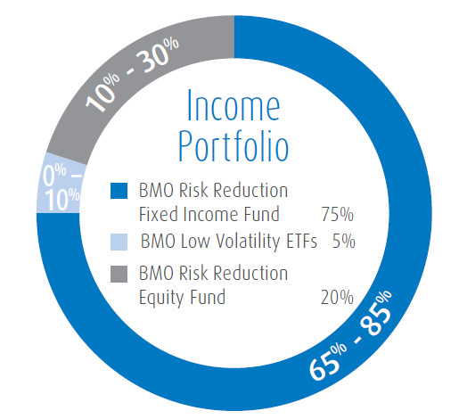
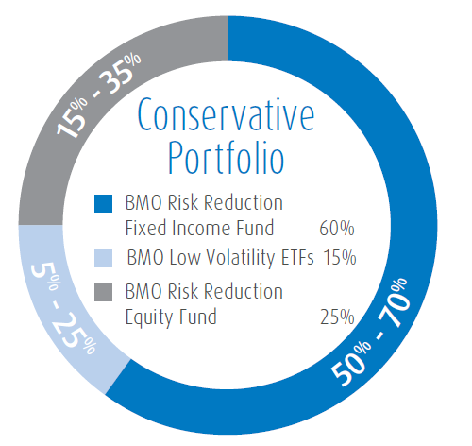
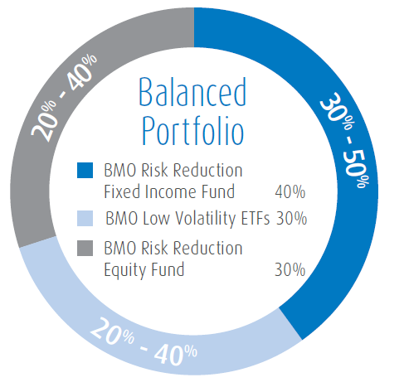
BMO Retirement Portfolios
Good for you now, better for you later
BMO Retirement Income Portfolio
BMO Retirement Conservative Portfolio
BMO Retirement Balanced Portfolio
Portfolio Manager | BMO Asset Management Inc.
Objective | Capital protection Some growth potential | Capital protection Increased focus on growth | Capital protection Focus on growth
For illustrative purposes only.
Source: Retirement Planning Presentation, BMO Wealth Institute 2016
Notes:
One of the solutions that I like and recommend for my clients are BMO’s Retirement Portfolios.
Combining protection and growth, BMO Retirement portfolios have been constructed to address many of the risks we discussed today.
Because investors have different goals, time horizons and tolerances for risk, there are three BMO Retirement Portfolio options, which can work alone or in combination in an investment portfolio. The BMO Retirement Portfolios all aim to protect your nest egg, but each portfolio varies in their degree of focus on growth.
The BMO Retirement Income Portfolio provides capital protection with some potential for growth.
The BMO Retirement Conservative Portfolio is for investors seeking capital protection and an increased focus on growth.
Finally, the BMO Retirement Balanced Portfolio is designed to provide capital protection and an increased focus on growth exposure over the BMO Retirement Conservative Portfolio.

Slide 38
BMO Retirement Portfolios
A solution for those approaching, or in retirement
BMO Retirement Portfolios
✔ | Manage risk / provide capital protection
✔ | Growth potential – outpace inflation & address shortfalls
✔ | Protection against sequence of returns risk (volatility)
✔ | Multiple options to suit individual investment goals
✔ | Support you through retirement
TFSAs are a
Source: Locked-in Retirement Plans, BMO Financial Group, February 2015
Notes:
BMO Retirement Portfolios help meet the income needs that are important to you as you approach your retirement.
They help protect your nest egg so you are not over-exposed to risk.
They offer protection from volatility by managing the sequence of returns.
By providing growth potential, they address the need to outpace inflation and address income shortfalls among more traditional investment sources.
And three portfolios provides you with the option of choosing the right portfolio for your desired risk level and desire for growth.
Ultimately, BMO Retirement Portfolios are designed to offer sustainable income throughout your retirement.
I can certainly help you integrate these products into your retirement income picture to help you address some of risk factors that we looked at today.

Slide 39
Summary and next steps
A wide range of factors to consider
Changing retirement landscape
Ongoing threat to savings – inflation, volatility, low returns
Many decisions and considerations to be made around retirement pensions
Source: Locked-in Retirement Plans, BMO Financial Group, February 2015
Notes:
Today we’ve looked at how several factors could impact the retirement income you may be anticipating. We’ve reviewed the key features and considerations of government retirement income and other sources.
There are many factors to consider and decisions to be made, and assessing and managing your retirement income is not a uncomplicated process. A thorough assessment of your retirement income needs, with thoughtful consideration of all the options available to you at this stage, will reveal opportunities to maximize income sources for your retirement.
I look forward to helping you with this process and thank you for your attention this [morning/afternoon/evening].

Slide 40
Disclaimers
This communication is for informational purposes only. While the information contained in this document is believed to be reliable, no guarantee is given that it is accurate or complete. The information contained herein is not, and should not be construed as, investment advice to any party. Investments should be evaluated relative to the individual’s investment objectives and professional advice should be obtained with respect to any circumstance.
This should not be construed to be legal or tax advice, as each client’s situation is different. Please consult your own legal and tax advisor.
BMO Global Asset Management is a brand name that comprises of BMO Asset Management Inc., BMO Investments Inc., BMO Asset Management Corp. and BMO’s specialized investment management firms.
BMO Mutual Funds are offered by BMO Investments Inc., a financial services firm and separate legal entity from Bank of Montreal. Commissions, trailing commissions, management fees and expenses all may be associated with mutual fund investments. Please read the prospectus of the mutual fund before investing. Mutual funds are not guaranteed, their values change frequently and past performance may not be repeated.

