Slide 1
Important wealth topics that matter to you

Slide 2


Living to 100: helping you prepare for the long road ahead
Notes:
This presentation has been provided by BMO Global Asset Management in conjunction with the BMO Wealth Institute. BMO Global Asset Management is one of the top 50 money managers in the world. With 425 investment professionals and 24 offices located globally, you can rely on their experienced teams to bring an in-depth knowledge of their region and expertise in their respective disciplines. As a multi-disciplined organization with deep experience in all asset classes, the firm is able to provide investors a wide range of wealth management solutions to suit their needs. This is why investors have entrusted BMO Global Asset Management to manage $279 billion USD (as of July 31, 2014) of their money to achieve their investment goals.
The BMO Wealth Institute provides insights and strategies around wealth planning and financial decisions to better prepare you for a confident financial future. The presentation references the Wealth Institute report published in July 2014. In this report, the BMO Wealth Institute partnered with Dr. Alexis Abramson, an industry expert for people over 50. She has a PhD in Gerontology and is a leading industry expert in the field of aging. If you have any questions, you may contact the BMO Wealth Institute by email at wealth.planning@bmo.com
[Note to presenter]
Make copies of the report/article/infographic available to audience

Slide 3

“If you live to be one hundred, you’ve got it made. Very few people die past that age.”
George Burns (1896 -1996)
Notes:
Hello, my name is [insert name] and I am [insert title]. Thanks for joining me today and welcome to our presentation on Longevity. Coming up will be some interesting stats on “Living to 100” in Canada, but I can tell you now that we’re living longer, which is great.

Slide 4
Longevity by the numbers
1970
2011
Canadian average life expectancy¹
Men: 69
Women: 76
Men: 79
Women: 84
Centenarian population growth²
2011
2061
6,000
78,000
Senior population growth³
2030
Double
¹Source: Statistics Canada, 2012
²Source: Statistics Canada, 2013
³Source: Department of Finance, Oct. 2012
Notes:
Did you know?
In Canada, as of the last census in 2011:
• We are now living 8 to 10 years longer than we did back in the 1970s
• 6,000 people were reported to be 100 years of age or older, and it is projected to be as many as 78,000 by 2061
• The number of seniors is projected to almost double by 2030.
Do you want to be a centenarian?
Without a doubt, advances in medical treatment and technology have allowed us to live longer. We are also becoming more aware of how important exercise and nutrition are to good health, contributing to longer lives as well. Today we will discuss in more detail what you can do to increase your chances of living to 100 or longer. I will also explain to you the major challenges, both from a health and financial standpoint that you may face by living longer and provide you with some practical advice for addressing these challenges.

Slide 5


Agenda
The four keys to longevity
Financial considerations
Solutions for good financial health
Summary and questions
Notes:
As you can see, we will look at the four keys to longevity, explore financial considerations and then reveal the solutions for good financial health. These are very interesting topics and relevant from a demographic perspective as our population ages, so I’m really looking forward to our discussion and to hearing your questions.

Slide 6

The four keys to longevity
Notes:
And now, let’s look at each of the four keys to longevity.
The four keys to longevity are aspects of life that many experts in the field of aging consider to be central keys to unlocking the mysterious door to longevity.

Slide 7




Keys to Longevity
The keys to living longer include having a healthy:
Body
Mind
Social Life
Finances
Notes:
The keys to living longer entail having a:
1. Healthy Body – by embracing and maintaining good health
2. Healthy Mind – enhancing ability to engage brain function
3. Healthy Social Network - staying connected with loved ones and friends
4. Healthy Finances – for a financially secure retirement to maintain the standard of living you desire
In the next few slides we’ll take an in-depth look at the four keys and explore some guidelines to embrace these keys, so you can enhance your ability to live long, happily, healthily and financially secure.
Please note the guidelines are only suggestions and that you should consult your physician for recommendations based on your on personal situation.

Slide 8
Biggest concerns about living to 100
(percent)
Source: BMO Wealth Institute survey by Pollara, March 2014
Notes:
It’s a good thing that many of us are now living well into our 80s, 90s and beyond. However, with that also comes some concerns and risks. Based on studies conducted by the BMO Wealth Institute, some of the biggest concerns about living longer contrasts with each of the four keys to longevity:
1. Body: No longer being physically able to do what you want to do
2. Mind: Losing mental abilities
3. Social Network: Losing the people they love
4. Financial: Not having enough to pay for things such as medical costs
These are all legitimate and potentially serious risks that many of us will encounter, so we must take sensible steps to manage these risks.

Slide 9

The four keys to longevity
Healthy body
Notes:
Let’s explore the four keys to longevity in more detail.
The first is maintaining a healthy body. As we age, it’s perfectly normal that we will have to put more effort into staying physically fit. Things just aren’t as easy for us as they were in our younger days, so we must work harder to eat right, stay within a healthy range of body weight, keep our muscles strong and maintain our flexibility and mobility.
I don’t think there’s anyone in this room who would disagree that we can enjoy our life more if we have good health and the freedom of movement. Nobody wants to spend their days constantly in the doctor’s office, in the hospital or confined indoors for large stretches of time.

Slide 10
Healthy body: specific tips
Adequate sleep
On average 7-8 hours for ≥65 years old
Regular stretching and deep breathing
Keeps joints flexible and body oxygenated
Physical activity
High- and low-impact exercise at least 3x/week
Proper hydration
Drink on average 8 glasses daily
Healthy diet
Eat more dark leafy vegetables, fruits and whole grains
Eat less unhealthy fats, processed sugars and preservatives
Moderate alcohol intake
One glass of red wine with dinner
Source: BMO Wealth Institute, Living to 100: The four keys to longevity, July 2014
Notes:
Let’s consider some practical things you can do to keep maintain a healthy body.
We need to make sleep a priority. The National Sleep Foundation recommends on average 7 to 8 hours of sleep for seniors. To help achieve this, consider creating a relaxing ritual and aim to sleep and wake up at roughly the same time each night. This can result in regulating your circadian rhythm, making it easier to fall asleep at night. Often referred to as the "body clock," the circadian rhythm is a 24-hour cycle that tells our bodies when to sleep and regulates many other physiological processes.
Regular stretching, deep breathing and exercise can keep you fit, but it can also help reduce stress, allowing you to sleep better. Staying physically active is one of the best things you can do for your health. It can help improve your physical fitness, manage and prevent diseases, improve your mood and increase your chances of living longer. Think about the activities you enjoy, such as walking, gardening, golfing, swimming, biking and dancing. If you can have a friend or spouse join you in these activities, even better. Socializing while participating in an activity can increase your enjoyment of the activity, help you stay motivated and prevent you from feeling isolated.
You want to stay properly hydrated, sipping on fluids throughout the day. The general rule of thumb is about 8 glasses a day, but this can vary depending on a number of factors. Consider eating more dark leafy vegetables, fruits and whole grains and avoiding bad fats like saturated or trans fats. It’s okay to drink occasionally, like a glass of wine with dinner.
If you adhere to these aspects of good health – at least most of the time – then you’ll be well on your way to having a healthy body in your later years.

Slide 11

The four keys to longevity
Healthy mind
Notes:
Of course, you want to pair a healthy body with a healthy mind, so that’s our next key to longevity. It’s a common myth that an older brain is not as sharp as a young one. Research tells us that comparisons between the human brain and computers suggest otherwise. We must take into consideration that an older mind has stored and processed much more information over the course of a lifetime than someone in, for instance, their 20s. Although the information is still accessible, at some point it begins to take longer to process, much like a well-used computer’s hard drive.
Most of us will experience a decline in brain function as we get older, but there are steps we can take to help minimize this decline.
I’m sure we all know senior citizens who remain extremely sharp-minded, possessing a quick wit, good memory and the ability to learn new things. Keeping a healthy mind doesn’t happen by accident. We need to stimulate our brains regularly to stay sharp, and the next slide will give us some tips on how to do just that.

Slide 12
Healthy mind: specific tips
Cognitive training exercises
Memory, reasoning, and speed-of processing exercises
Regular aerobic exercise
Moderate to vigorous exercise weekly
No smoking
Maintain social networks
Volunteer work, part-time job, close-knit bonds
Source: What Is the Best Way To Improve Your Brain Power For Life? Bergland, Christopher. Psychology Today. January 21, 2014.
Notes:
The brain, just like the muscles of the body, requires regular exercise to stay sharp. We can do many activities to improve our memory and keep our brains stimulated. Rather than resisting change and being intimidated by something unknown to us (for example, new advances in technology), we should embrace change and try to keep learning on a regular basis. Mature adults are rising to the challenge by adapting to the technology wave and incorporating activities that challenge the thinking process, including surfing the web, online games and using an electronic reader.
Maintain your social network to stay engaged with people and participate in mind-stretching conversations or even spirited debates. Working part-time or volunteering will keep your brain active, while getting enough exercise and not smoking are good for both your body and mind.
• Cognitive training: Memory, reasoning, and speed-of processing exercises create a winning combination for cognition.
Aerobic exercise: People who exercise at least moderately, just once a week, are 30% more likely to maintain their cognitive function than those who don’t exercise.
• Don’t smoke: Non-smokers are nearly twice as likely to stay sharp in old age as those who smoke.
• Maintain social networks: People who work, volunteer and maintain close-knit human bonds are 24% more likely to preserve cognitive function in late life.
There is no doubt that all of these activities sharpen your cognitive skills – again it is important to consult with your physician for appropriate recommendations based on your personal situation.

Slide 13

Healthy social life
The four keys to longevity
Notes:
Next, we consider the social aspects of leading a healthy life. What’s your passion? Doing things with friends and family is fun and good for you.

Slide 14

“Those who regularly interact with their friends and peers are often the happiest and the healthiest, especially when social connections are maintained and preserved over the course of a lifetime.”
Alexis Abramson, Ph.D. Gerontologist
Notes:
Staying connected is key to a healthy social life. As said by U.S. gerontologist, Dr. Alexis Abramson – “Those who regularly interact with friends and peers are often the happiest and healthiest.”

Slide 15
Healthy Social Life: specific tips
One tip sums it all: Connectivity
Volunteer or get a part-time job
Engage in conversations with others
Visit or invite friends and relatives
Take a continuing education class or join a senior center
Studies* show lack of social connectedness leads to:
Increase stress
Hardening of arteries and inflammation of body
Diminished brain function, learning and memory
* Source: Research conducted by John Cacioppo, a University of Chicago social psychologist and neuroscientist who studies the biological effects of social isolation.
Notes:
There are various ways to achieve a healthy social life. Participating in a meaningful activity, such as volunteering, may help you feel healthier and happier. Once you retire, you may have the time to volunteer in your community. And volunteering can help you feel productive and valuable to others. Think about your skills and the activities you find enjoyable when looking for opportunities to volunteer. Places you may be able to volunteer include your place of worship, hospital, school, homeless shelter, library, animal shelter or senior centre. The simple act of a good conversation with a close friend or family member can provide acceptance, understanding, compassion and even an occasional wake-up call when necessary.
Seniors who are isolated may suffer from more health issues than those with strong social connections. Interacting with others may reduce your stress level, feelings of depression, dependency and risk of developing dementia. If you need help establishing more frequent social interactions, the following ideas may help:
• Join a senior centre
• Invite a friend to lunch or dinner
• Offer to babysit your grandchildren
• Get a part-time job
• Take a continuing education class at your local college or university
• Visit relatives
• Volunteer

Slide 16
New activities during old age
(percent)
Source: BMO Wealth Institute survey by Pollara, March 2014
Notes:
Since most of us are retired or semi-retired in our later years, we’ll have the time to expand our interests and increase our social interaction on our own terms. This is the aspirational stuff that TV commercials and marketing brochures focus on: the freedom in our golden years to do whatever we find personally rewarding and fulfilling.
Do you have a personal bucket list? The popularity of personal bucket lists has ignited a passion in seniors to take up new hobbies, write their life story or develop new careers. You may be wondering why many want to work during retirement, isn’t the point of retirement to retire from work? Perhaps, but many choose to find a part-time job to stay sharp and active, and to maintain social interactions with others.

Slide 17

The four keys to longevity
Healthy finances
Notes:
Before moving onwards, let’s just do a quick recap. Thus far we have discussed three keys to longevity: Body, Mind and Social, and how they are influential to longevity from a non-financial perspective. The last of our four keys to longevity focuses on the financial aspect of longevity. Healthy finances are crucial to enjoying life at any stage, particularly more so when you’re older and your income is fixed or reduced simply because you have stopped working full-time.
Although people are often nervous or uncertain when it comes to money matters, financial security is crucial to leading a satisfying life in old age – and it’s certainly attainable if you take a logical approach to it. Let’s look at some of the important financial considerations you should be aware of, and prepared for.

Slide 18
Key Risks That Impact Retirement
Longevity Risk
Potential to live longer than expected and not having enough retirement savings
Inflation Risk
Potential rise in inflation during retirement reducing your ability to maintain your living standard
Market Risk
Potential for negative performance of investments on your retirement savings, particularly during drawdown phase
Health Care and Long-term Care Risk
Potential to have greater health and long-term care expenses than anticipated, and then need to withdraw additional capital from your retirement savings
Notes:
From a financial planning standpoint, there are four key risks I want to mention that may concern those who exceed the typical life expectancy:
Longevity Risk – The dramatic increase in life expectancy has allowed many Canadians to enjoy a longer retirement. However, this change has created a requirement for extra savings.
Inflation Risk – As the cost of goods and services increase over time, the value of a dollar today will fall in relation to what it can buy in the future.
Market Risk – Is a key determinant when the portfolio is in drawdown phase. Keep this in consideration when constructing a portfolio to source retirement income.
Health Care and Long-term Care Risk – One’s health can impact retirement either positively or negatively. Good health may prolong life and necessitate need for sustainable retirement income. Poor health may result in additional health care and long-term care expense that will require additional unplanned withdrawals from capital.
In the next few slides we shall explore in more detail how these four risks impact longevity from a financial perspective.

Slide 19
Longevity Risk
Longevity Risk
Unknown Planning Horizon
Macro/ Market
Inflation
Personal Spending
Investment Volatility
Interest Rate Volatility
Public Policy & Taxation
Sequence of Returns
Rising Costs of Living
Health Care
Long-term Care
Help Family Members
Divorce
Fraud/Theft
Source: Forbes, http://www.forbes.com/sites/wadepfau/2014/03/18/retirement-risks-it-all-starts-with-longevity/ (Accessed Feb 18, 2015)
Notes:
We discussed that in general, Canadians are living longer. But, how much longer? The reality is that we cannot predict the future and don't know exactly how much longer. Longevity risk can be considered as the overarching risk, because the longer a retirement lasts, the higher the likelihood of exposure to Market, Inflation, Health and Long-term Care risks.
[Below is only for presenter’s reference from the source]:
“As illustrated, longevity risk becomes the overarching risk, because the longer a retirement lasts, the greater are the chances that other forms of risk will manifest. Increased longevity means more time for another financial crisis, more time for inflation to compound, increased chances for an expensive health problem, etc. In this particular taxonomy, remaining retirement risks are broken into three general categories falling under longevity.
First, macro/market risks identify the exposure of a retirement plan to macroeconomic forces beyond a retiree’s control. These risks include investment volatility related to poor market returns and disadvantageous fluctuations in interest rates. Public policy is also a concern, as unexpected increases in taxes, reduced government benefits, or increased health care costs can all serve to increase pressures on a spending plan. Finally, sequence or returns risk is included in this category. This is a macroeconomic risk with a more personalized impact, as retirees attempting to fund a constant spending stream from a portfolio of volatile assets are particularly vulnerable to the specific sequence of market returns experienced in the early part of their retirement. It is not just the average return which matters, but also the order of the returns. Poor returns early in retirement will lead to an increased spending rate from the portfolio of remaining assets, digging a hole for the retiree which will be increasingly difficult to overcome even if markets enjoy a subsequent boom.
A second category of risk for retirees is inflation. This is also a macroeconomic risk, but perhaps it deserves its own category as retirees may not realize the full extent of their exposure to inflation. For retirees living on a fixed income, rising prices will slowly erode purchasing power. Things will get more expensive. Even if inflation averages about 3% per year, the cost-of-living doubles in just 23 years. In other words, a fixed income will buy half of what it could at the start of retirement. A lot of retirements will last longer than this. Another concern is that the cost-of-living for retirees may rise faster than the general population, especially as increasingly costly health care makes up a larger portion of a retirement budget .
The third category relates to personal spending risks. These risks are essentially that the basic budget one has prepared for retirement will not adequately reflect actual costs. Issues here include unexpected health care and long-term care expenses, the need to support other family members such as adult children or grandchildren, or divorce. The death of a spouse is also a relevant consideration, as Social Security benefits will decrease by a third to a half, taxes will increase as there are fewer exemptions, and the surviving spouse may be less knowledgeable about the intricacies of the retirement plan. Fraud and theft are growing concerns for retirees as well, as a real issue we face are reduced cognitive abilities as we age and a number of predators will seek to exploit this.”

Slide 20
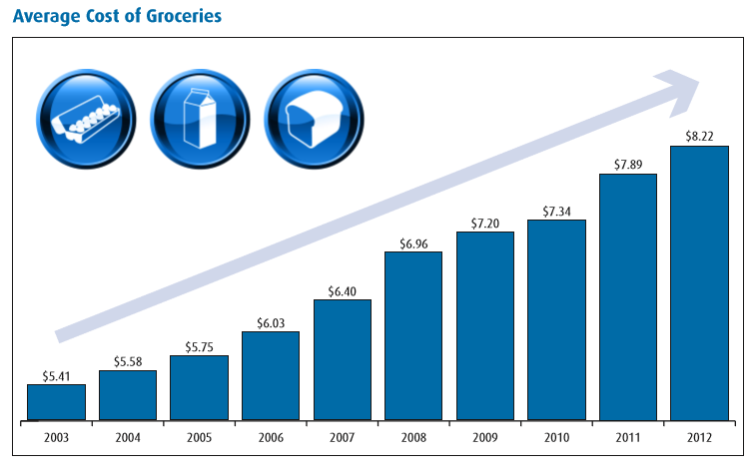
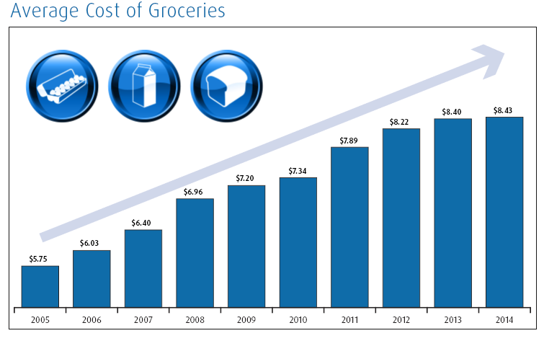
Inflation Risk
Inflation represents a general rise in the prices of goods and services, reducing buying power over time.
Over the past 10 years, your typical cost of groceries has increased close to 50%, but has your salary increased by 50%?
Your savings needs to grow sufficiently to keep pace with inflation
This chart illustrates the average total cost of one dozen eggs, one litre of partly skimmed milk and a loaf of bread in Canada each year.
Source: StatsCan CANSIM tables
Notes:
Inflation represents a general rise in the prices of goods and services, reducing buying power over time. This bar chart can help you visualize the negative effects of inflation on your savings. Groceries – such as bread, milk and eggs – that are everyday necessities for living, has increased almost 50% over the past 10 years. If your salary hasn’t increased by 50%, how are you keeping pace with inflation?

Slide 21
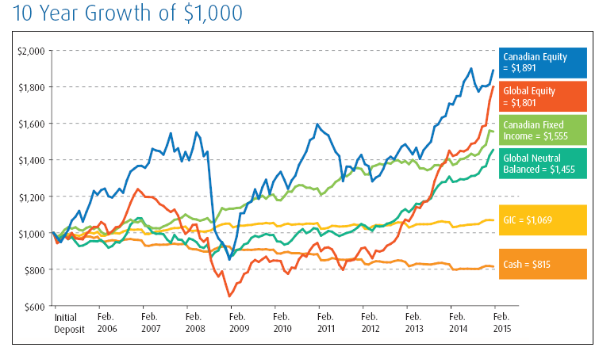
Inflation Risk: Cash is safe but can it be too safe?
Inflation means that you would have lost over 18% of your savings’ value over the past 10 years.
This chart illustrates the returns of cash, Morningstar Average 5 Yr GIC (GIC), S&P/TSX Composite Index (Canadian Equity), FTSE TMX Canada Universe Bond Index (Canadian Fixed Income), 50% S&P/TSX Composite Index and 50% FTSE TMX Canada Universe Bond Index (Canadian Neutral Balanced), MSCI World Index (Global Equity), and 50% MSCI World Index and 50% Barclays Global Aggregate Bond Index (Global Neutral Balanced) after taking into account the average annual Canadian rate of inflation.
Source: Morningstar Direct and Bloomberg, February 2015
Notes:
This chart illustrates that over the long term, staying in cash or investing in only safe vehicles such as GICs, your retirement savings would not be able to keep up with inflation. Your savings would have lost more than 18% of its value over the past 10 years. Therefore, you are at great risk of not being able to maintain your standard of living during your retirement years.
Looking at this same chart, you can see how an event like the market downturn of 2008 would have put a major dent in the retirement savings of many Canadians. For those in the accumulation phase with more time to save for retirement, there was time to recoup from those losses. For example, if you made a $1,000 investment in Canadian equities, you would have doubled your savings over the 10 years, despite the losses in 2008.

Slide 22
Market Risk
Hypothetical Example:
Beginning balance for Fund A and B is $100,000
Over 20 years both funds:
Average return is 4.8%
Variability is 16.4%
Balance is $250,000
If $5,000/year (adjusted for inflation) is withdrawn from funds
Balance for Fund A is zero after year 15 due to negative returns in early years
Balance for Fund B is approximately $70,000 by year 20
 | Fund A | Balance | Fund B | Balance
 |  | $100,000 |  | $100,000
Year 1 | -18.39% | $77,528 | 17.56% | $111,681
Year 2 | -19.14% | $58,506 | 8.72% | $115,796
Year 3 | -4.59% | $50,712 | -3.35% | $106,736
Year 4 | 18.47% | $53,510 | 26.33% | $127,836
Year 5 | 6.79% | $51,018 | 19.62% | $146,050
Year 6 | 14.30% | $51,527 | -13.64% | $120,994
Year 7 | -15.39% | $38,395 | 17.68% | $135,150
Year 8 | 14.59% | $36,709 | 11.11% | $143,101
Year 9 | 8.95% | $32,821 | 16.39% | $158,891
Year 10 | 19.52% | $31,084 | -10.44% | $136,199
Year 11 | 20.72% | $29,011 | -9.76% | $116,537
Year 12 | 16.21% | $25,230 | 13.81% | $124,319
Year 13 | 21.03% | $21,391 | -25.91% | $86,506
Year 14 | -1.61% | $13,353 | 9.45% | $86,120
Year 15 | 13.92% | $5,992 | 29.68% | $101,185
Year 16 | 11.88% | $0 | 18.77% | $110,233
Year 17 | 32.85% | $0 | 2.56% | $104,163
Year 18 | 6.94% | $0 | 7.84% | $102,657
Year 19 | 7.25% | $0 | 14.99% | $107,368
Year 20 | -31.57% | $0 | -28.79% | $69,612
Average Return | 4.8% |  | 4.8%
Variability | 16.4% |  | 16.4%
Notes:
However, for those who were on the verge of retirement, the downturn in 2008 may have altered their retirement plans significantly. The experience may have shaken their faith in the market’s ability to provide sustainable earnings, causing them either to resign themselves to living with less or, in some cases, to postpone their retirements. Sequence of returns is the actual order of the returns. A bad year or two in the early years of retirement can have a major impact on how long your retirement savings will last. That is because you have to draw down from the capital of an already-shrunken asset. The impact of the sequence of returns on a retirement portfolio is called market risk. Let’s take a look at an example of this…
Hypothetically, there are two funds that have the same average return of 4.8% and the same variability of 16.4% over time. What that means is that, had you invested $100,000 in either of those two funds, at the end of the 20 years, you would have close to $250,000 in either fund, even though the sequence of returns was very different.
But what if you take these two funds and start to withdraw money – let’s say $5,000 adjusted for inflation – every year? Which of the two funds do you think ends up with more money at the end of the 20-year period? After all, they have the same average and the same variability. Do you think they end up in the same place after 20 years? Absolutely not.
As you run down the funds, you will notice that Fund A is doing a lot worse than Fund B. In fact, Fund A runs out of money completely around the 15th year. Fund B actually ends up surviving to the end of the 20 years and you have about $70,000 remaining.
Why is there such a big difference? When you're withdrawing money, the sequence of returns has an enormous impact. In fact, if you will take a look at the very top, the first few years of Fund A were a lot worse than the first few years of Fund B. The average was the same. They reversed themselves over time. But if something goes wrong in the first few years of retirement, you'll have to reduce your standard of living. You will not be able to produce the same income stream.
What's the takeaway from something like this? Well, first of all, you have to make sure you understand the risks you run with your portfolio as you get closer to retirement. You must pay attention to sequence-of-returns risk. About five years before retirement and about seven to 10 years after retirement, sequence of returns will have a big impact on the sustainability of your portfolio.

Slide 23
Health Care and Long-term Care Risk
Largest expenses in old age
(percent)
Source: BMO Wealth Institute survey by Pollara, March 2014
Notes:
The costs for health care are trending upwards, especially as a result of longer life expectancies. It’s not a surprise that people in the BMO Wealth Institute survey believe that medical and health care will be the largest expenditures in old age. Yes, in Canada we have a health care system that covers many basic medical costs, but even then there are expenses that we must pay ourselves. In a BMO Wealth Institute survey, Canadians said they expect to spend, on average, more than $5,000 a year on out-of-pocket medical costs after age 65 – and inflation will drive that number higher in the future.
Food for thought
According to the Fraser Institute, the overall cost of health care in Canada has increased at a greater rate than the cost for other necessities. Between 2004 and 2014, health care costs rose by 53.3%, an amount higher than the increase in the cost of shelter (40.7%), clothing (33.4%) and food (15.6%).

Slide 24
Health Care and Long-term Care Risk
Cost of private care
Province | Retirement homes/ residences |  | Nursing homes
 | Yearly cost minimum | Yearly cost maximum | Yearly cost minimum | Yearly cost maximum
Alberta | $12,000 | $65,000 | $18,100 | $22,100
B.C. | $13,000 | $70,000 | $11,650 | $37,100
Manitoba | $15,000 | $42,000 | $12,400 | $28,900
New Brunswick | $9,600 | $54,000 | N/A | $41,250
Newfoundland and Labrador | $20,100 | $50,000 | N/A | $33,600
Nova Scotia | $23,000 | $72,000 | $22,500 | $38,000
Ontario | $14,000 | $132,000 | $20,800 | $29,300
P.E.I. | $7,200 | $63,000 | N/A | $28,300
Quebec | $6,000 | $42,000 | $13,200 | $21,100
Saskatchewan | $16,600 | $60,000 | $12,600 | $23,900
Source: Senioropolis Inc., 2014
Notes:
One of the realities for older Canadians is the increased potential to need long-term care. Even if we are proactive and take tangible steps – like the ones discussed earlier – to help ourselves stay healthy, sometimes old age robs us of our ability to remain independent. It could be medical issues, a lack of mobility, dementia or any other unfortunate reason, but many seniors find themselves in need of long-term care, and that can be expensive.
On this slide we can see some rough minimum and maximum annual provincial costs for private long-term care for retirement residences or nursing homes. The numbers are staggering and don’t even factor in spouses. Furthermore, the costs are subject to inflation over time.
Paying for health care and long-term care expenses may require an unexpected withdrawal of additional capital as costs rises, which in turn has an impact on how long your retirement savings will last.

Slide 25

Healthy finances
Solutions for your good financial health
Notes:
I’ve just provided an overview on how longevity, inflation, market, health care and longer-term care risk can impact your retirement. Are you prepared to handle these risks? Do you feel confident that you will have enough savings to last all of your retirement years?

Slide 26
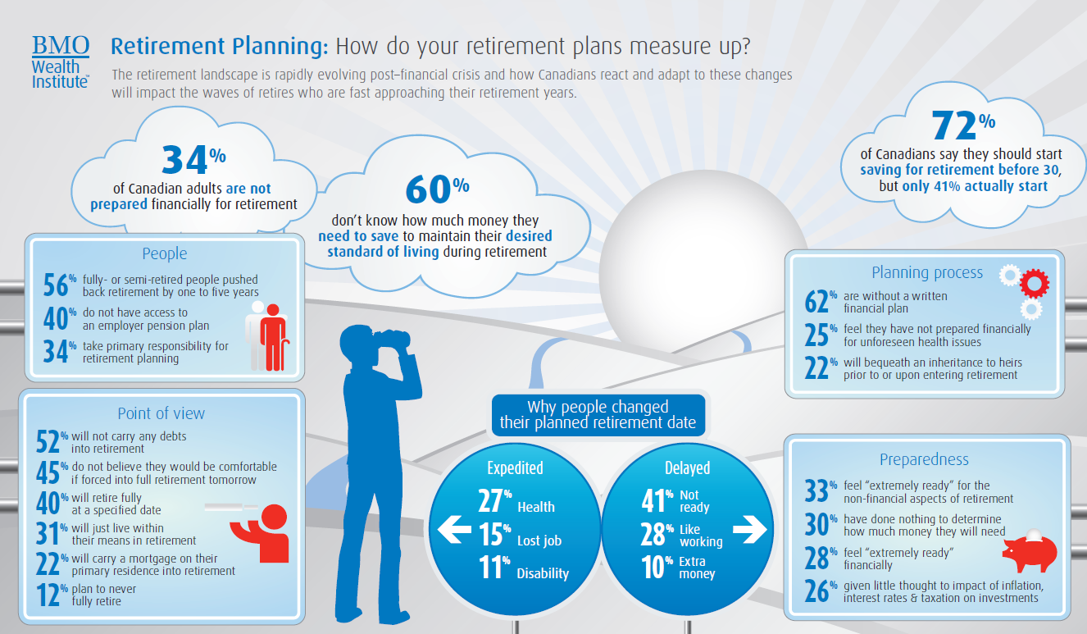
Are you prepared for retirement?
Source: BMO Wealth Institute, Retirement Planning: How do your retirement plans measure up?, February 2014.
Source: BMO Wealth Institute, Retirement Planning, February 2015
Notes:
If you said no or wavered on any of those questions, you are not alone. The BMO Wealth Institute measured Canadians preparedness around retirement and found that:
34% of Canadian adults are not prepared financially for retirement
72% of Canadians said they should have started saving for retirement before 30, but only 41% actually started
60 % don’t know how much money they need to save to maintain their desired standard of living during retirement
The good news is it’s never too late to strengthen your financial situation. Naturally, it’s ideal to start saving and investing at a young age, but you can always take steps now to improve your financial circumstances in the future.

Slide 27
Steps to prepare for retirement
Save and invest for growth – Make regular automatic contributions
RRSPs, TFSAs and Employer Saving Programs
Have an investment strategy that addresses key risks:
Longevity Risk - Consider products that offer a guaranteed income
Life annuities
Inflation Risk - Invest in products with potential to provide tax-efficient, inflation-adjusted returns or incomes
Dividend Funds
Market Risk - Implement retirement income planning strategies
Managed programs or lifecycle funds
Health Care Risk and Long-Term Care Risk – Set aside a portion of your savings for additional costs and purchase long-term care insurance
Notes:
Some ways to improve your financial circumstances is to save and invest for growth. You can do so by making regular automatic contributions to RRSP, TFSA and Employer Savings Programs if available.
Longevity Risk – Assess your sources of guaranteed income and consider products that offer a guaranteed income such as life annuities. Life annuities provide a steady income stream through the life of your retirement.
Inflation Risk – Invest in products that have the potential to provide tax-efficient, inflation-adjusted returns or incomes such as dividend funds. Dividend funds provide you with growth potential through investment in equities with the security and stability of dividend income. Another benefit of dividend income is that it is tax more favourably relative to interest income.
Market Risk – You can implement retirement income planning strategies. Have a diversified portfolio of both fixed income securities and equities and reposition your portfolios to become more conservative for drawdown in retirement. You can consider investing in managed program or life cycle funds that to get all-in-one access to a target asset mix of equities and fixed income that vary based on investment objectives and timeframe until retirement.
Health Care and Long-term Care Risk – You can budget for health care costs and purchase long-term care insurance which provides a daily tax-free benefit to cover the costs of a nursing home or professional in-home care.

Slide 28
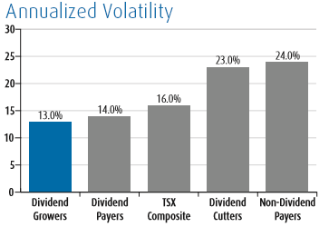
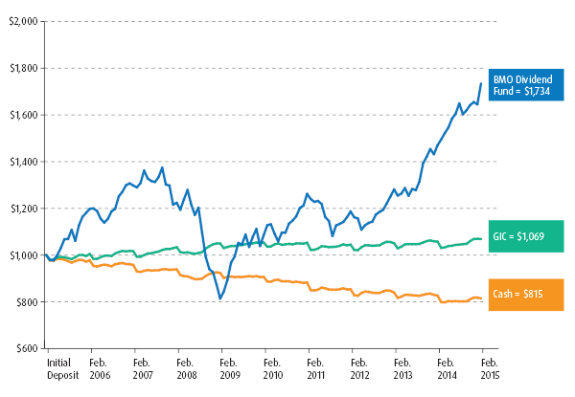
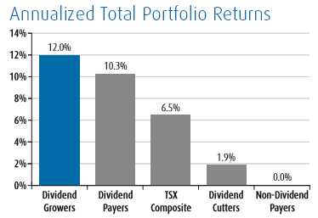
Mitigate Inflation Risk: BMO Dividend Fund
Core equity fund that provides income and capital growth
Invests in quality dividend-paying growers in Canada in the U.S., which has produced excellent risk-adjusted returns
Source: Morningstar Direct, February 2015
Past performance is not indicative of future results.
Notes:
Let’s explore how to mitigate against inflation risk a bit further. As I mentioned in the previous slide, this can be achieved by investing in dividend funds in your retirement portfolio.
Looking at the bar charts, equities that pay dividends and grow their dividends are less volatile and have outperformed non-dividend paying equities over the long-term. The BMO Dividend Fund is a great example of this. This fund identifies high-quality dividend payers and growers and takes advantage of opportunities in the U.S. to add greater sector, security and country diversification, while including some of Canada’s largest blue-chip companies. As you can see on this line graph, the performance of the BMO Dividend Fund has proven to outpace inflation over the long-term.

Slide 29
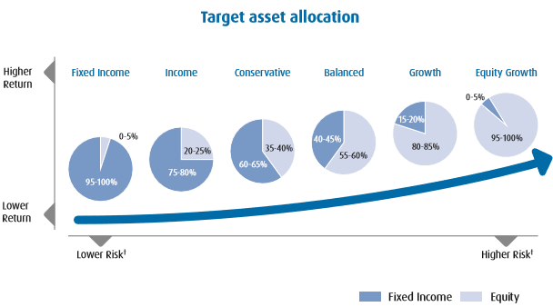
Mitigate Market Risk: BMO SelectTrustTM Portfolios
Portfolios that target a maximum potential return based on an individual’s risk profile
Diversified portfolio of actively managed funds and passively managed ETFs combined in a single mutual fund
†Risk is defined as the uncertainty of a return and the potential for capital loss in your investment.
Notes:
Now, let’s look at how to mitigate against market risk and sequence of returns by investing in a diversified portfolio and repositioning your portfolio as you move from the accumulation phase to decumulation. BMO SelectTrustTM Portfolios is a managed program with a set of diversified portfolios that combines both actively managed funds and passively managed ETFs. Each portfolio has a target asset mix of equities and fixed income that vary based on investment objectives and risk profiles. As a result, with the BMO SelectTrustTM portfolios you can switch within the program to match your risk tolerance and timeframe for retirement. In other words, the further away you are from retirement, you can consider the growth portfolio with a higher mix of equities to grow your savings, as you continue to approach retirement you can switch to the balanced portfolio, then conservative portfolio. As you get much closer to retiring and becoming more conservative, you can consider switching to the income portfolio.
So, we reviewed ways to prepare for retirement, taking into consideration investments products that can help you mitigate the risks that arise from living longer in retirement. However, having the discipline to invest regularly and the conviction to meet a long-term financial goal can be a challenge. Overall planning for retirement can be a daunting task that many simply cannot handle on their own.
As a financial professional, I can work with you to manage the risks that that and help you to prepare for the retirement you want. I have access to all the tools, research and support required to help you achieve your retirement goals.
It all starts with a Financial Plan.

Slide 30

Financial planning keeps you on track
A comprehensive financial plan will help you address questions like:
What will your retirement look like?
Who will be a part of your retirement?
What do you want to do in this next stage of life?
How are you going to pay for the retirement you envision for yourself?
How do you proactively plan and prepare for the four risks in retirement?
Notes:
When preparing for your retirement, a financial plan can be a powerful tool. Financial planning takes into account all aspects of your personal and financial situation. A good financial plan can help you answer important questions:
What will your retirement look like?
What do you want to do in this next stage of life?
How are you going to pay for the retirement you envision for yourself?
Most importantly, how do I proactively plan and prepare for the four risks in retirement?
As such, each plan looks somewhat different and will need to evolve to reflect any changes in your life, expectations, financial situation and goals.
I have clients who have asked these questions, and I have worked with them to understand their personal financial situation and build a personalized comprehensive financial plan. I can help you as well.

Slide 31

The value of professional advice
A financial professional can help you:
Regularly save/invest more money
Use tax-advantaged plans and investments
Benefit from government-sponsored programs
Create, monitor and adjust your customized financial plan
Engage experts in other specialized fields, as required
Notes:
I can’t emphasize enough how important it is to seek advice from a financial professional.
According to the BMO Wealth Institute report measuring Canadians preparedness around retirement, almost three-quarters of Canadians feel the role of their current financial advisor will continue into retirement. And of those who had already retired, they valued this relationship even more, with most indicating that their advisor has played a prominent role in their transition into retirement.
I can help you:
Save more money on a regular basis
Make better use of tax-advantaged plans and investments
Benefit from government sponsored programs such as CPP/OAS and minimize claw-backs
Develop a financial plan and frequently review your plan with you, making adjustments as your circumstances change. I will continuously work with you to maintain focus on a long-term financial plan, despite any short-term economic issues or market volatility
If you need specialized help in a certain area, I can also engage the services of experts in tax planning, trust and estate planning, accounting and much more
My job is to help you manage the risks of living longer and prepare you financially for your retirement, no matter how long it may be. I want to ensure you don’t outlive your retirement savings.

Slide 32




Summary
The keys to living longer include having a healthy body, mind, social life and finances
An easy way to embrace these keys is to remember the 5 Fs:
Family
Fitness
Food
Fun
Finances
Family
Fitness
Food
Fun
Finances
Notes:
I would like to recap what we discussed today.
We looked at the four keys to longevity – a healthy body, healthy mind, healthy social life and healthy finances – and explored some practical tips for each of these keys. As a takeaway, an easier way to embrace the keys to longevity is to remember the 5 F’s – Family, Fitness, Food, Fun, and Finances. Most centenarians have these tenets in common:
Family – Connect like a Centenarian: Consider topics such as spousal connections, intergenerational activities, legacy considerations and caregiving.
Fitness – Move like a Centenarian: Regular exercise can help control weight, reduce risk of disease, improve mental health and enhance chances of living longer.
Food – Eat like a Centenarian: The body depends on the foods eaten for energy, strength, and overall fitness.
Fun – Enjoy life like a Centenarian: Participating in enjoyable activities is a good way to maintain well-being and lower risk of developing health problems, including
dementia.
Finances – Afford to be a Centenarian: The other four Fs will be dependent on planning and managing one’s finances now and in the future.

Slide 33
Summary
Financial considerations
Inflation risk
Longevity risk
Market risk
Health care and long-term care risk
Solutions for good financial health
Talk to a financial professional for help
Develop a financial plan
Notes:
Then we went into more detail about the risks that can negatively impact your retirement savings. Finally, we discussed solutions for good financial health, which involves working closely with a trusted financial professional and creating a personalized comprehensive financial plan that will help you meet your needs, both now and in the future.
Let me help you with the healthy finances key, so you can focus on the other keys to living a longer happy life.

Slide 34
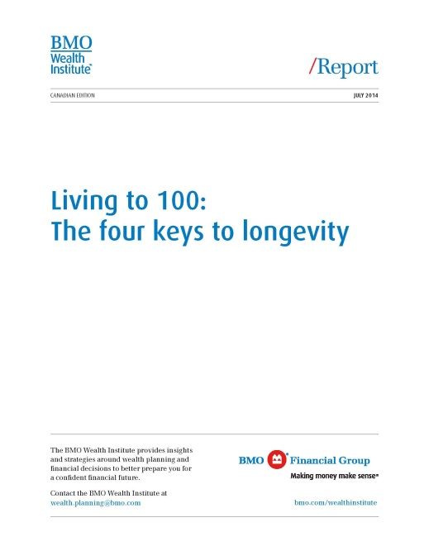
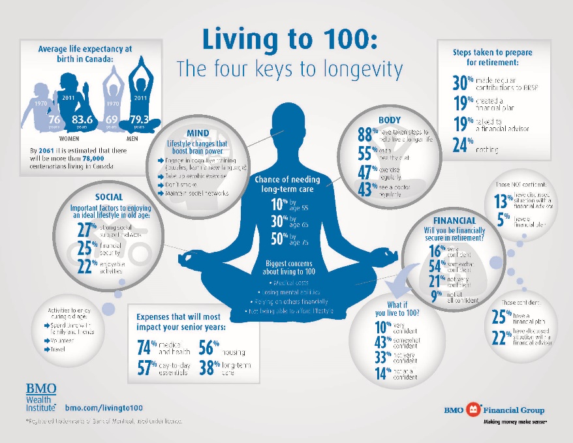
Get a copy of our report
Presenter name
Contact information
Thank you.
Notes:
This concludes today’s presentation. Thanks for your time and attention. You’ve been a great audience and I hope you gained some insights into the keys to longevity and how you can prepare yourself for a happy, meaningful and rewarding retirement.
Please feel free to contact me anytime if you would like me to help you develop and maintain a comprehensive financial plan that will serve your needs now and in the future. My contact details are onscreen or you can take one of my business cards.
I also have copies of BMO’s full “Living to 100” report that we referenced today, plus BMO’s handy, at-a-glance infographic that neatly summarizes many of the key points we discussed. Please help yourself to these resources on your way out.

Slide 35
Disclaimer
This communication is for information purposes. While the information contained in this document is believed to be reliable, no guarantee is given that it is accurate or complete. The information contained herein is not, and should not be construed as, investment advice to any party. Investments should be evaluated relative to the individual’s investment objectives and professional advice should be obtained with respect to any circumstance.
BMO Global Asset Management is a brand name that comprises BMO Asset Management Inc., BMO Investments Inc., BMO Asset Management Corp. and BMO’s specialized investment management firms.
BMO Mutual Funds are offered by BMO Investments Inc., a separate entity from Bank of Montreal. Commissions, trading commissions, management fees and expenses all may be associated with mutual fund investments. Please read the prospectus before investing. The indicated rate of return are the historical annual compounded total return including changes in unit value and reinvestment of all distributions and does not take into account sales, redemption, distribution or optional charges or income taxes payable by any unitholder that would have reduced returns. Mutual Funds are not guaranteed, their values change frequently and past performance may not be repeated.
BMO ETFs are managed and administered by BMO Asset Management Inc., an investment fund manager and portfolio manager and separate legal entity from Bank of Montreal. Commissions, management fees and expenses all may be associated with investments in exchange traded funds. Please read the prospectus before investing. Exchange traded funds are not guaranteed, their values change frequently and past performance may not be repeated.
BMO Life Assurance Company is the issuer of the BMO Guaranteed Investment Funds (BMO GIF) contract and the guarantor of the guarantee provisions therein. The BMO GIF information and Policy Provisions provide full details and govern in all cases. Any amount that is allocated to a segregated fund is invested at the risk of the policy owner and may increase or decrease in value.
All logos and trademarks of other companies are the property of those respective companies.
® “BMO (M-bar roundel symbol)” is a registered trade-mark of Bank of Montreal, used under licence.

